Slide 1

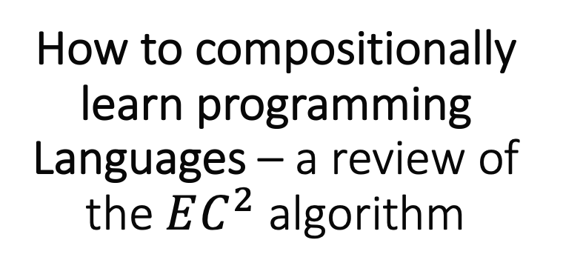
How to compositionally learn programming Languages – a review of the $EC^{2}$ algorithm
By Brando Miranda

Slide 2
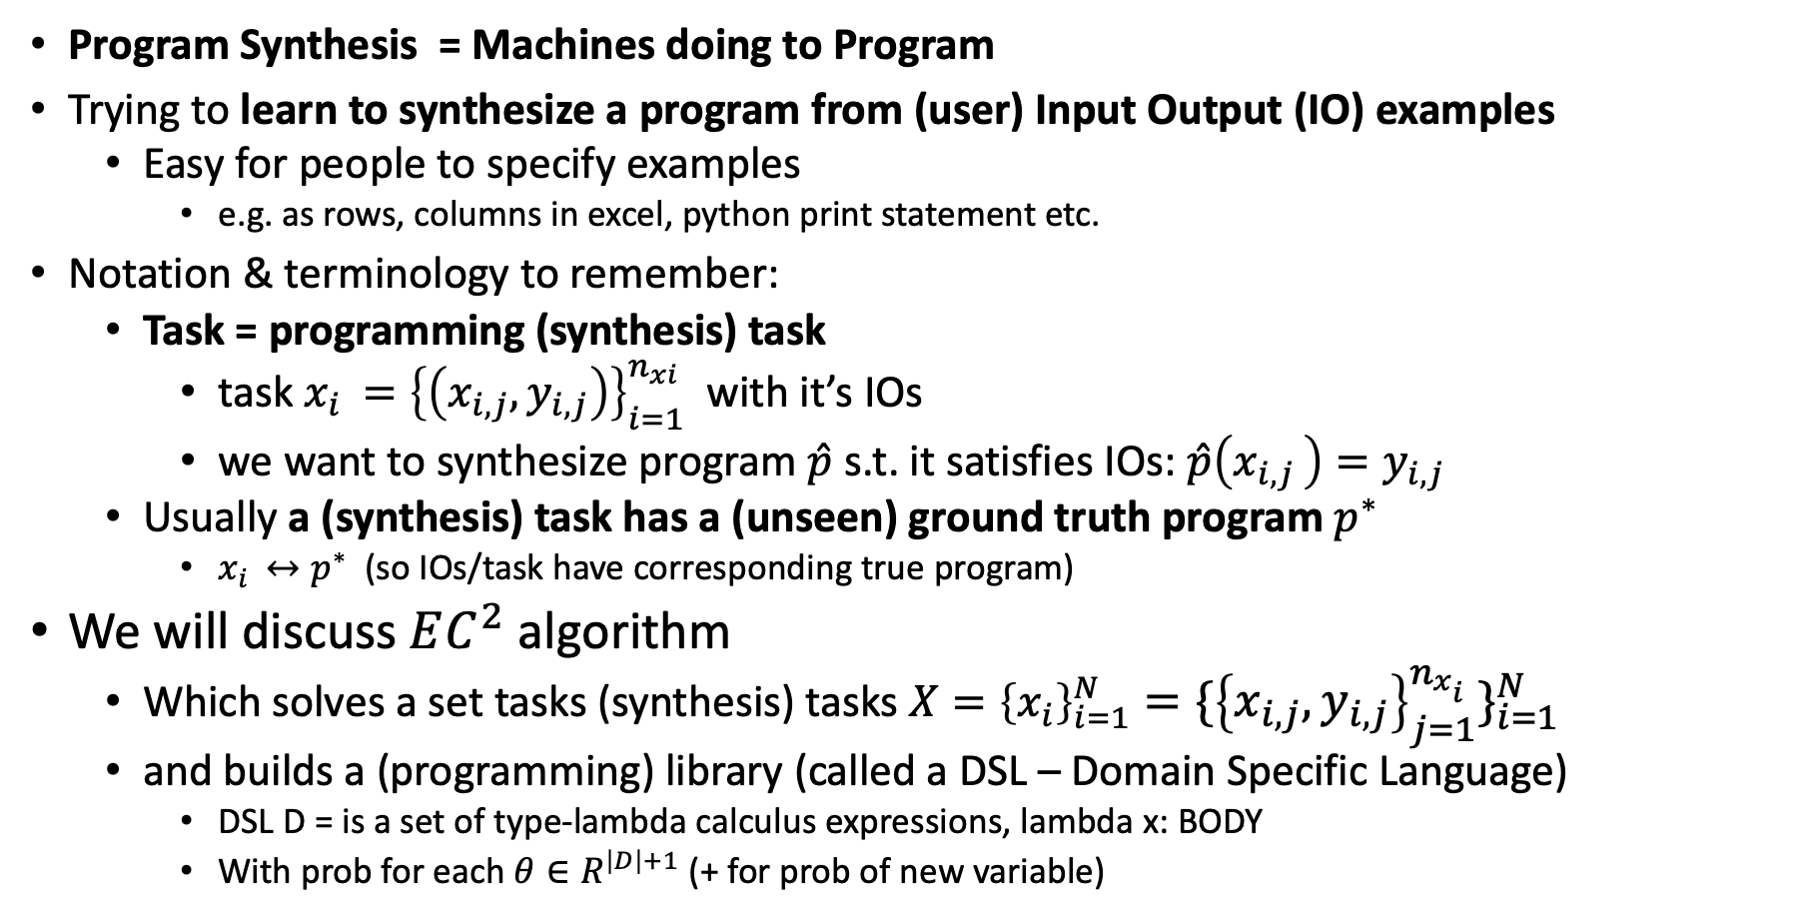
What is (inductive) program synthesis ?
Program Synthesis = Machines doing to Program
Trying to learn to synthesize a program from (user) Input Output (IO) examples
Easy for people to specify examples
e.g. as rows, columns in excel, python print statement etc.
Notation & terminology to remember:
Task = programming (synthesis) task
task $x_{i }={\left\{\left(x_{i,j}, y_{i,j}\right)\right\}}_{i=1}^{n_{xi}}$ with it’s IOs
we want to synthesize program $\hat{p}$ s.t. it satisfies IOs: $\hat{p}\left(x_{i,j }\right)=y_{i,j}$
Usually a (synthesis) task has a (unseen) ground truth program $p^{∗}$
$x_{i }↔p^{∗}$ (so IOs/task have corresponding true program)
We will discuss $EC^{2}$ algorithm
Which solves a set tasks (synthesis) tasks $X={\left\{x_{i}\right\}}_{i=1}^{N}={\{{\left\{x_{i,j}, y_{i,j}\right\}}_{j=1}^{n_{x_{i}}}\}}_{i=1}^{N}$
and builds a (programming) library (called a DSL – Domain Specific Language)
DSL D = is a set of type-lambda calculus expressions, lambda x: BODY
With prob for each $θ∈R^{\left|D\right|+1}$ (+ for prob of new variable)

Slide 3
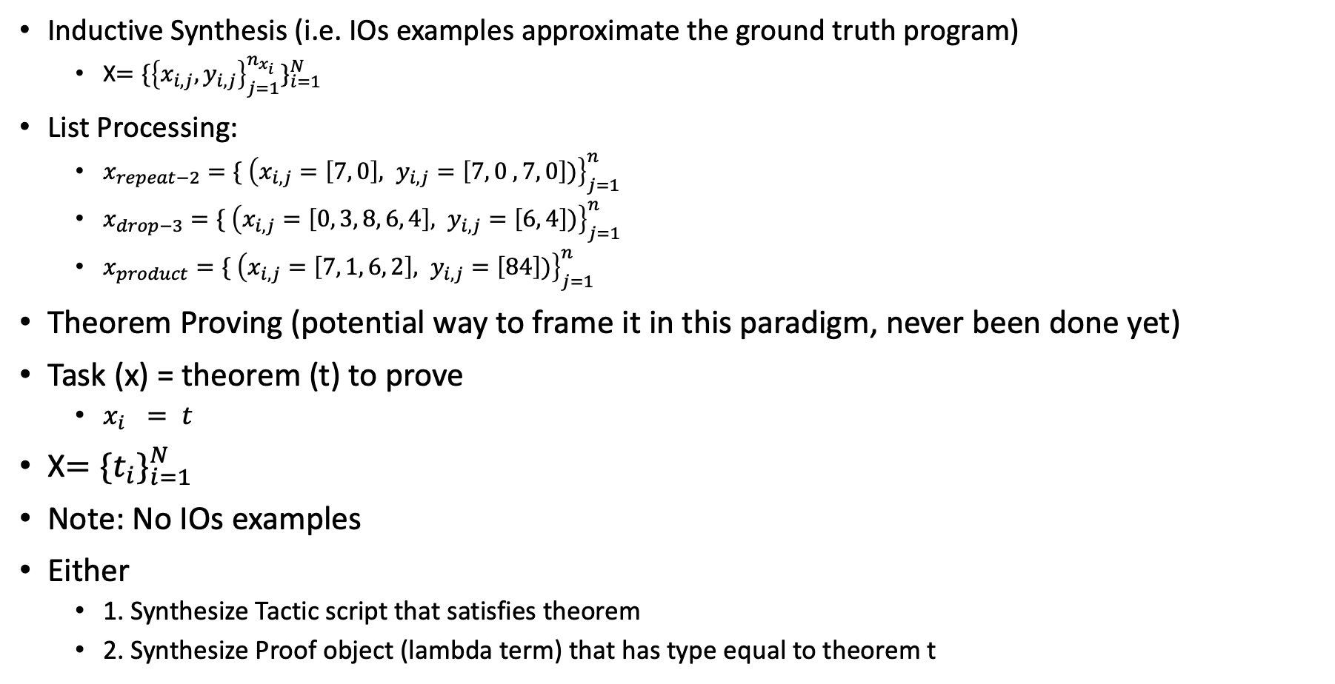
Example (synthesis/programming) tasks
Inductive Synthesis (i.e. IOs examples approximate the ground truth program)
X$={\{{\left\{x_{i,j}, y_{i,j}\right\}}_{j=1}^{n_{x_{i}}}\}}_{i=1}^{N}$
List Processing:
$x_{repeat−2}=\{ {\left(x_{i,j}=\left[7, 0\right], y_{i,j}=\left[7, 0 , 7, 0\right])\right\}}_{j=1}^{n}$
$x_{drop−3}=\{ {\left(x_{i,j}=\left[0, 3, 8, 6, 4\right], y_{i,j}=\left[6, 4\right])\right\}}_{j=1}^{n}$
$x_{product}=\{ {\left(x_{i, j}=\left[7, 1, 6, 2\right], y_{i,j}=\left[84\right])\right\}}_{j=1}^{n}$
Theorem Proving (potential way to frame it in this paradigm, never been done yet)
Task (x) = theorem (t) to prove
$x_{i} = t$
X$={\{t_{i}\}}_{i=1}^{N}$
Note: No IOs examples
Either
1. Synthesize Tactic script that satisfies theorem
2. Synthesize Proof object (lambda term) that has type equal to theorem t

Slide 4
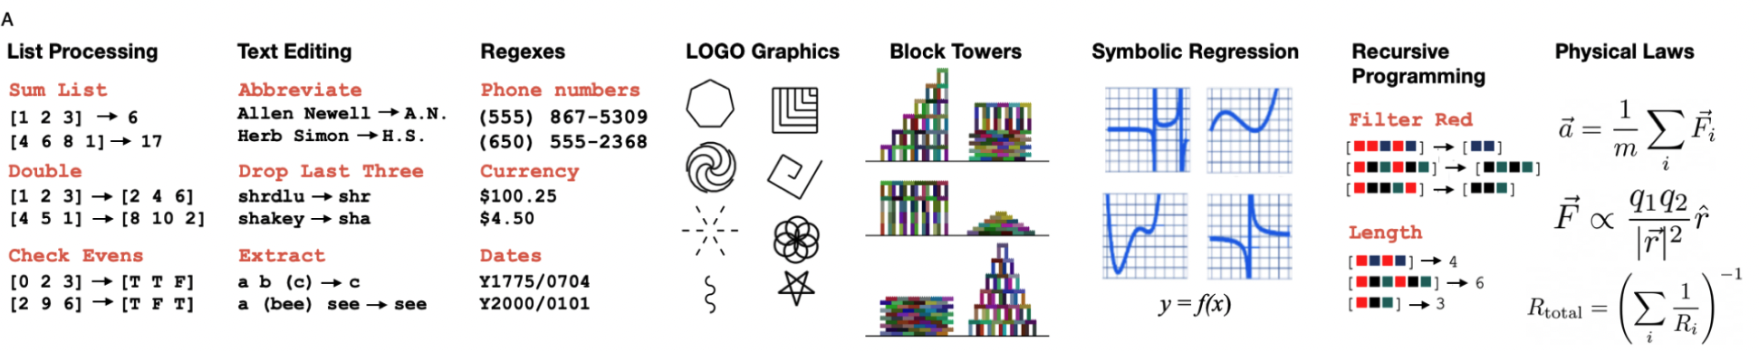
Examples diverse set of tasks that EC^2 solves
Note: meta-learns diverse set of task via compositionality & re-sharing of library components!

Slide 5
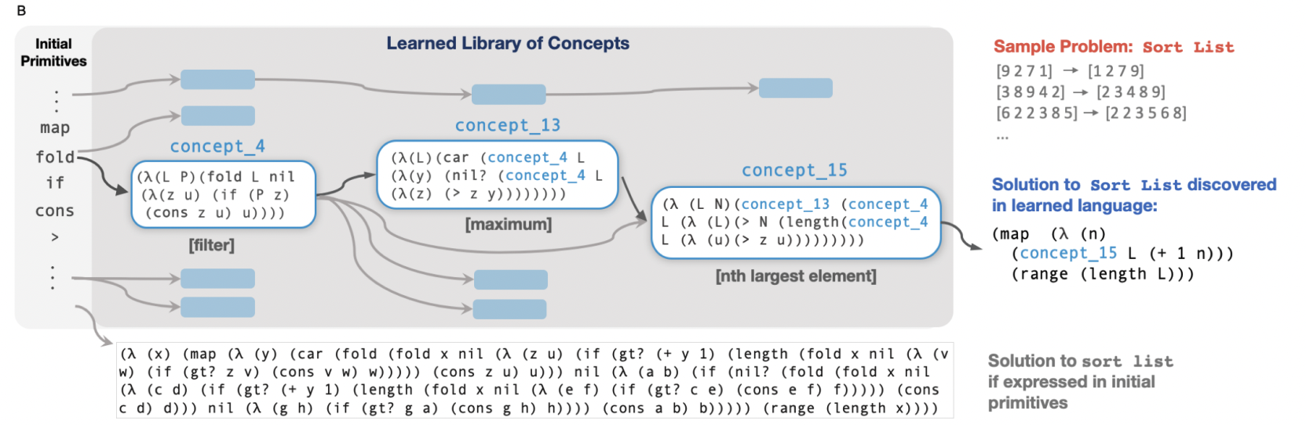
Example library (DSL) EC^2 can learn
10^80

Slide 6
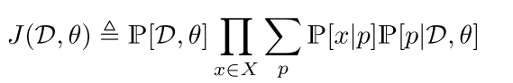
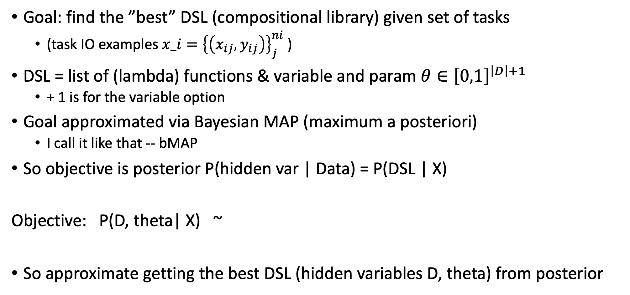
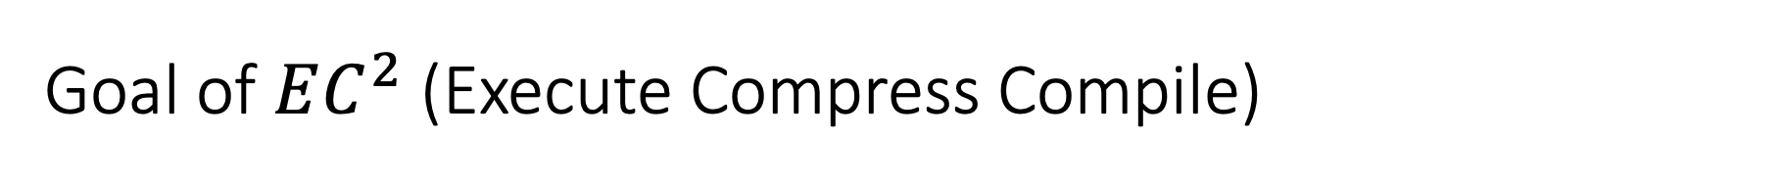
Goal of $EC^{2}$ (Execute Compress Compile)
Goal: find the ”best” DSL (compositional library) given set of tasks
(task IO examples $x_i={\left\{\left(x_{ij}, y_{ij}\right)\right\}}_{j}^{ni}$ )
DSL = list of (lambda) functions & variable and param $θ∈{\left[0,1\right]}^{\left|D\right|+1}$
+ 1 is for the variable option
Goal approximated via Bayesian MAP (maximum a posteriori)
I call it like that -- bMAP
So objective is posterior P(hidden var | Data) = P(DSL | X)
Objective: P(D, theta| X) ~
So approximate getting the best DSL (hidden variables D, theta) from posterior

Slide 7
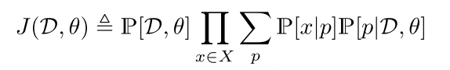
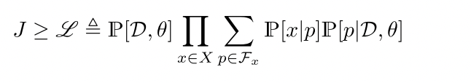
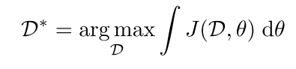
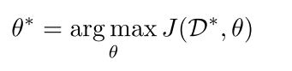
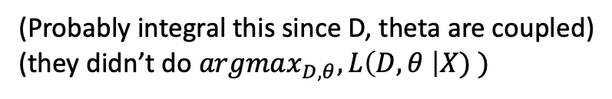
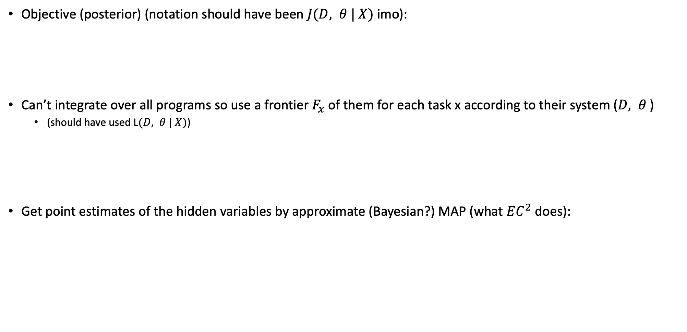
So how is learning defined? – Maximize MAP Lower Bound
Objective (posterior) (notation should have been $J(D, θ | X)$ imo):
Can’t integrate over all programs so use a frontier $F_{x}$ of them for each task x according to their system ($D, θ$)
(should have used L$(D, θ | X)$)
Get point estimates of the hidden variables by approximate (Bayesian?) MAP (what $EC^{2}$ does):
<- this looks Bayesian
(Probably integral this since D, theta are coupled)
(they didn’t do $argmax_{D, θ}, L\left(D, θ \right|X) )$

Slide 8
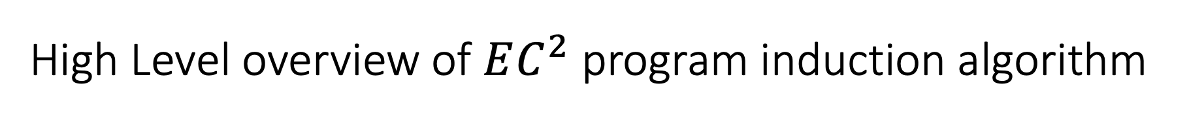
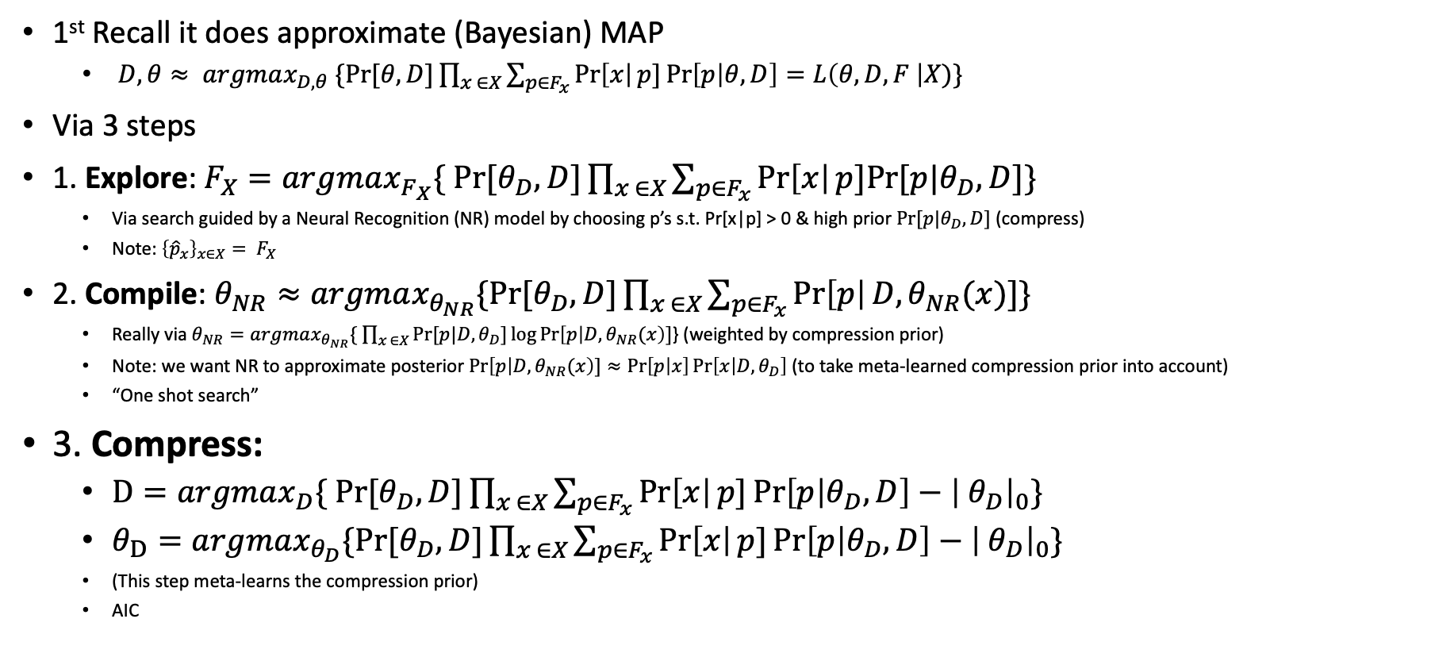
High Level overview of $EC^{2}$ program induction algorithm
1st Recall it does approximate (Bayesian) MAP
$D, θ≈ argmax_{D, θ} \{Pr⁡[θ,D]\prod_{x ∈X}{\sum_{p∈F_{x}}{\operatorname{Pr}\left[x\right|p]\operatorname{Pr}\left[p | θ, D\right]=L\left(θ, D, F \right|X)\}}}$
Via 3 steps
1. Explore: $F_{X}=argmax_{F_{X}}\{ Pr⁡[θ_{D},D]\prod_{x ∈X}{\sum_{p∈F_{x}}{\operatorname{Pr}\left[x\right|p]Pr⁡[p|θ_{D}, D]\}}}$
Via search guided by a Neural Recognition (NR) model by choosing p’s s.t. Pr[x|p] > 0 & high prior $Pr⁡[p|θ_{D}, D]$ (compress)
Note: ${{\left\{{\hat{p}}_{x}\right\}}_{x∈X}= F}_{X}$
2. Compile: $θ_{NR}≈argmax_{θ_{NR}}\{Pr⁡[θ_{D},D]\prod_{x ∈X}{\sum_{p∈F_{x}}{\operatorname{Pr}\left[p\right|D, θ_{NR}(x)]\}}}$
Really via $θ_{NR}=argmax_{θ_{NR}}\{ \prod_{x ∈X}{Pr⁡[p|D, θ_{D}]\log{\operatorname{Pr}\left[p | D, θ_{NR}(x\right)]}}$} (weighted by compression prior)
Note: we want NR to approximate posterior $\operatorname{Pr}\left[p | D, θ_{NR}(x\right)]≈\operatorname{Pr}\left[p | x\right]\operatorname{Pr}\left[x | D, θ_{D}\right]$ (to take meta-learned compression prior into account)
“One shot search”
3. Compress:
$D=argmax_{D}\{ Pr⁡[θ_{D},D]\prod_{x ∈X}{\sum_{p∈F_{x}}{\operatorname{Pr}\left[x\right|p]\operatorname{Pr}\left[p | θ_{D}, D\right]−{\left| θ_{D}\right|}_{0}\}}}$
$θ_{D}=argmax_{θ_{D}}\{Pr⁡[θ_{D},D]\prod_{x ∈X}{\sum_{p∈F_{x}}{\operatorname{Pr}\left[x\right|p]\operatorname{Pr}\left[p | θ_{D}, D\right]−{\left| θ_{D}\right|}_{0}\}}}$
(This step meta-learns the compression prior)
AIC
Notes:
Note:
Pr[p|D, theta_D=theta_NR(x)] = q(p|x)
Note:
During explore step, the prior Pr[p|\theta_D D] assigns high probability to the programs learned during ”prior learning” i.e. that are compressed.

Slide 9
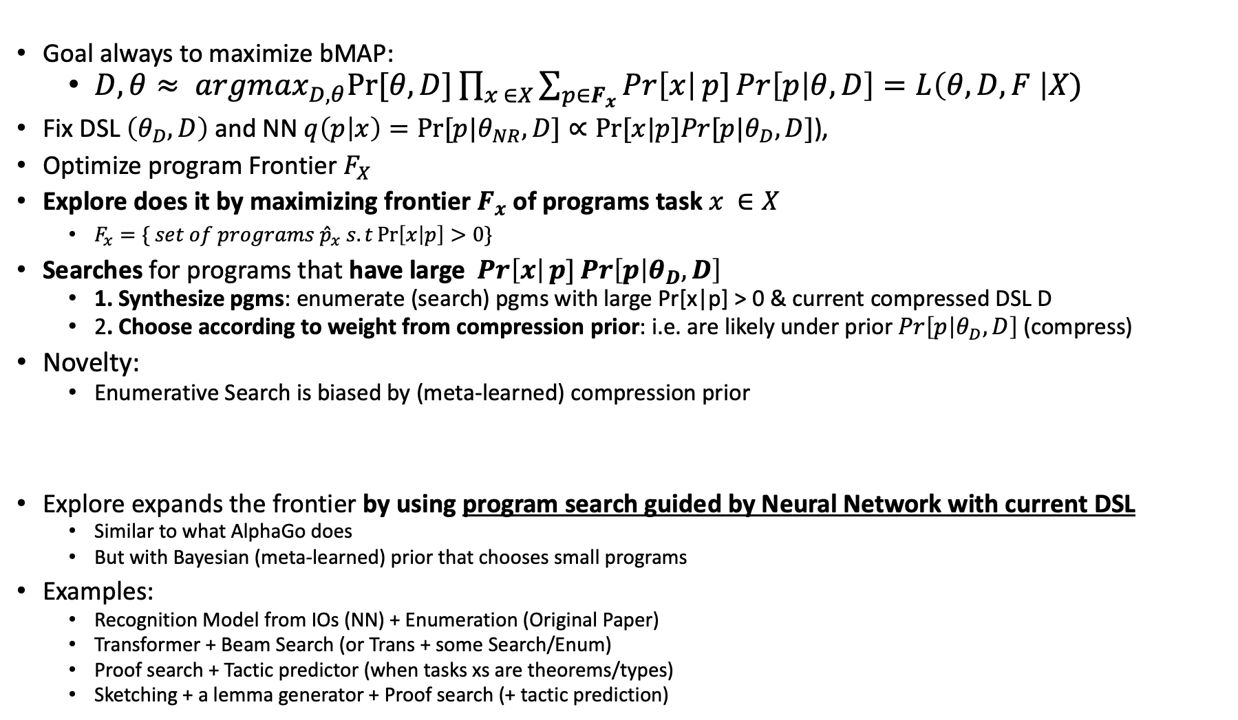
Explore: Searching for programs
Goal always to maximize bMAP:
$D, θ≈ argmax_{D, θ}Pr⁡[θ,D]\prod_{x ∈X}{\sum_{p∈F_{x}}{\operatorname{Pr}\left[x\right|p]\operatorname{Pr}\left[p | θ, D\right]=L\left(θ, D, F \right|X)}}$
Fix DSL$\left(θ_{D}, D\right)$ and NN $q\left(p | x\right)=Pr⁡[p|θ_{NR}, D]∝Pr⁡[x|p]Pr[p|θ_{D}, D]\text{)}$,
Optimize program Frontier $F_{X}$
Explore does it by maximizing frontier $F_{x}$ of programs task $x ∈X$
$F_{x}=\{ set of programs {\hat{p}}_{x} s.t\operatorname{Pr}\left[x | p\right]>0\}$
Searches for programs that have large $\operatorname{Pr}\left[x\right|p]\operatorname{Pr}\left[p | θ_{D}, D\right]$
1. Synthesize pgms: enumerate (search) pgms with large Pr[x|p] > 0 & current compressed DSL D
2. Choose according to weight from compression prior: i.e. are likely under prior $\operatorname{Pr}\left[p | θ_{D}, D\right]$ (compress)
Novelty:
Enumerative Search is biased by (meta-learned) compression prior
Explore expands the frontier by using program search guided by Neural Network with current DSL
Similar to what AlphaGo does
But with Bayesian (meta-learned) prior that chooses small programs
Examples:
Recognition Model from IOs (NN) + Enumeration (Original Paper)
Transformer + Beam Search (or Trans + some Search/Enum)
Proof search + Tactic predictor (when tasks xs are theorems/types)
Sketching + a lemma generator + Proof search (+ tactic prediction)
Notes:
Constants are found by differentiating through program- so via GD
Why not use fancy enumeration? Point of their work is to show simple/general enumeration + DSL can make program induction tractable
Sort of like minimum assumption to make it work – the ML approach
Also enumeration can be applied to any problem, then NN & DSL are tasked with learning the details!
Q: is Pr[x|p]Pr[p|theta, D] what the neural network q outputs or what?
I think the neural network induces a probability $\operatorname{Pr}\left[x\right|p]\operatorname{Pr}\left[p | θ, D\right]$ and the enumerative approach ensures that the most likely program is found, thereby increasing bMAP objective
Similar to have a transformer with beam search would achieve the same thing
NN amortizes the cost of finding programs (I like to think of it as approximation a NP machine)

Slide 10
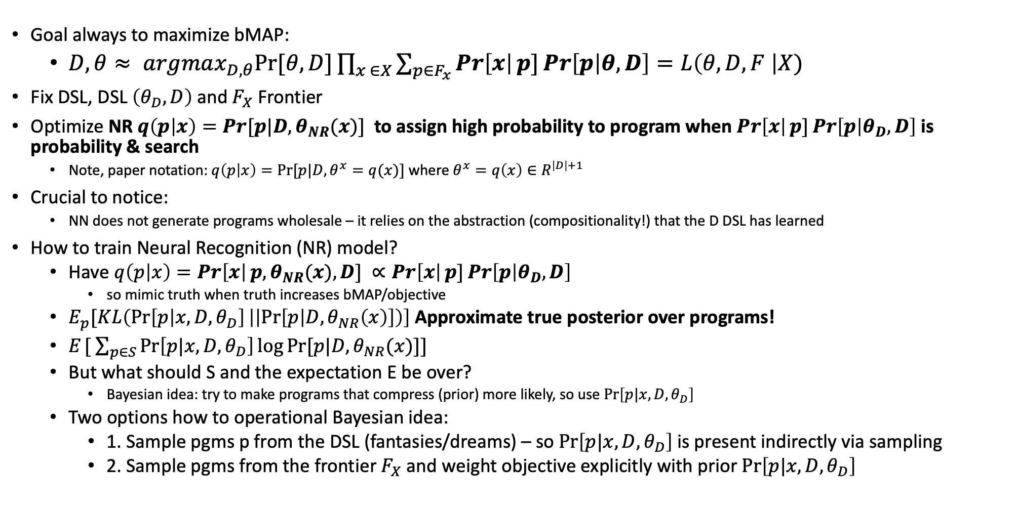
Compile (1): train neural network to “compile” programs in the current DSL
Goal always to maximize bMAP:
$D, θ≈ argmax_{D, θ}Pr⁡[θ,D]\prod_{x ∈X}{\sum_{p∈F_{x}}{\operatorname{Pr}\left[x\right|p]\operatorname{Pr}\left[p | θ, D\right]=L\left(θ, D, F \right|X)}}$
Fix DSL, DSL$\left(θ_{D}, D\right)$ and $F_{X}$ Frontier
Optimize NR $q\left(p | x\right)=Pr[p|D, θ_{NR}(x)]$ to assign high probability to program when $\operatorname{Pr}\left[x\right|p]\operatorname{Pr}\left[p | θ_{D}, D\right]$ is probability & search
Note, paper notation: $q\left(p | x\right)=Pr⁡[p|D, θ^{x}=q(x)]$ where $θ^{x}=q\left(x\right)∈R^{\left|D\right|+1}$
Crucial to notice:
NN does not generate programs wholesale – it relies on the abstraction (compositionality!) that the D DSL has learned
How to train Neural Recognition (NR) model?
Have $q\left(p | x\right)=\operatorname{Pr}\left[x\right|p, θ_{NR}(x), D] ∝Pr\left[x\right|p]\operatorname{Pr}\left[p | θ_{D}, D\right]$
so mimic truth when truth increases bMAP/objective
$E_{p}[KL\left(\operatorname{Pr}\left[p | x, D,θ_{D}\right] | \left|\operatorname{Pr}\left[p | D, θ_{NR}\left(x\right)\right]\right)\right]$ Approximate true posterior over programs!
$E_{ }[ \sum_{p∈S}{\operatorname{Pr}\left[p|x, D, θ_{D}\right]\log{Pr⁡[p|D,θ_{NR}(x)]}]}$
But what should S and the expectation E be over?
Bayesian idea: try to make programs that compress (prior) more likely, so use $\operatorname{Pr}\left[p|x, D, θ_{D}\right]$
Two options how to operational Bayesian idea:
1. Sample pgms p from the DSL (fantasies/dreams) – so $\operatorname{Pr}\left[p|x, D, θ_{D}\right]$ is present indirectly via sampling
2. Sample pgms from the frontier $F_{X}$ and weight objective explicitly with prior $\operatorname{Pr}\left[p|x, D, θ_{D}\right]$
Notes:
Confusing to me. $\operatorname{Pr}\left[x\right|p, θ, D] ∝Pr\left[x\right|p]\operatorname{Pr}\left[p | θ, D\right]$ isn’t the “truth” that is a model too. So it’s confusing to me what q is actually doing…I think they assume they are Bayesians and think their model is the true model (i.e. they likely have a way to get that probability without the NN and then train the NN to be similar to that). But due to the factorization of Pr[p|D, theta, D] – this is actually a model and they are slightly wrong
KL(Data || Model) so first is usually truth (or samples of data perhaps? This is where the cross entropy comes from so recall it later…)
Question: what is theta fixed to?

Slide 11
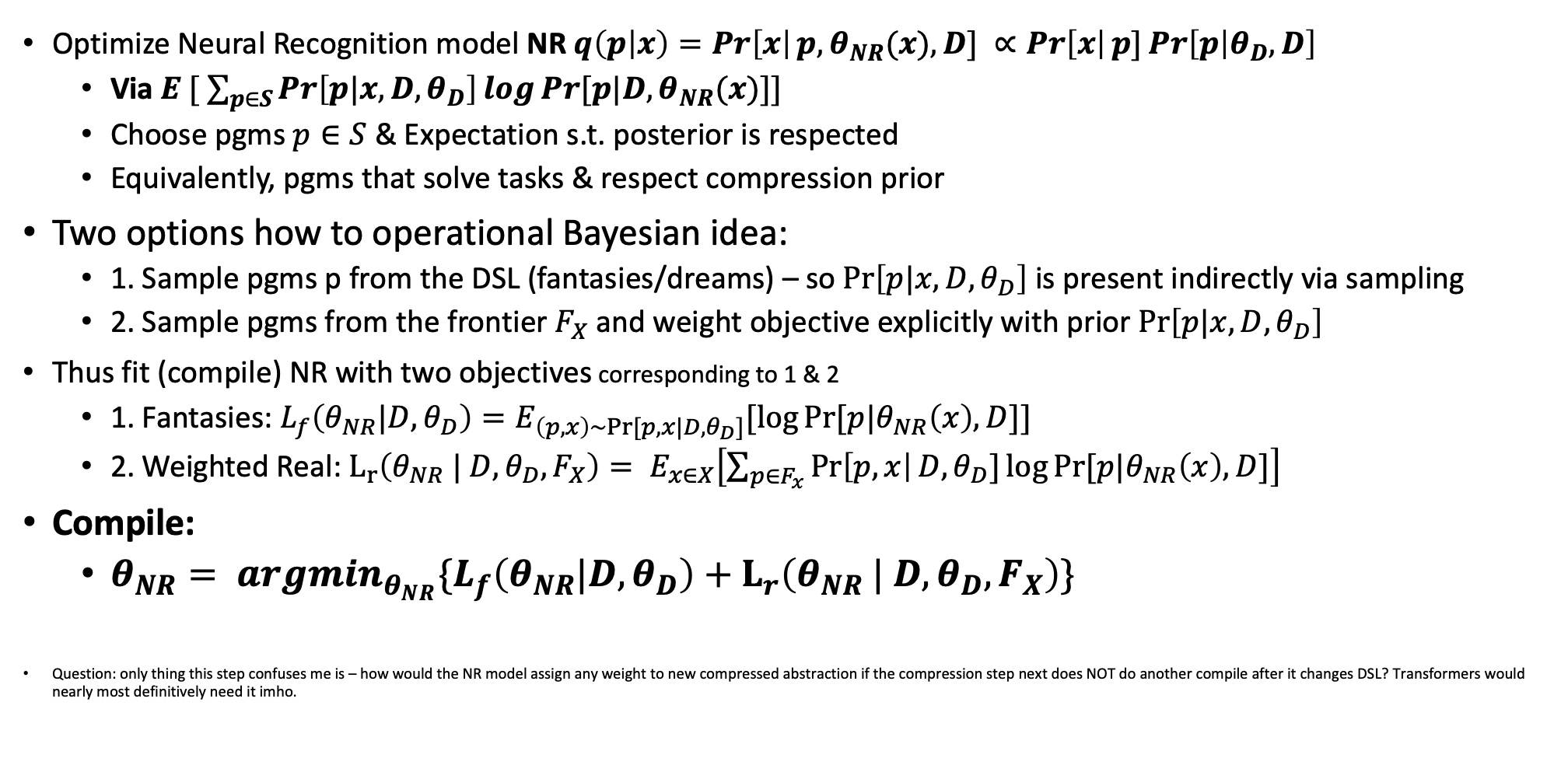
Compile (2): train neural network to “compile” programs in the current DSL
Optimize Neural Recognition model NR $q\left(p | x\right)=\operatorname{Pr}\left[x\right|p, θ_{NR}(x), D] ∝Pr\left[x\right|p]\operatorname{Pr}\left[p | θ_{D}, D\right]$
Via $E_{ }[ \sum_{p∈S}{\operatorname{Pr}\left[p|x, D, θ_{D}\right]\log{Pr⁡[p|D,θ_{NR}(x)]}]}$
Choose pgms $p∈S$ & Expectation s.t. posterior is respected
Equivalently, pgms that solve tasks & respect compression prior
Two options how to operational Bayesian idea:
1. Sample pgms p from the DSL (fantasies/dreams) – so $\operatorname{Pr}\left[p|x, D, θ_{D}\right]$ is present indirectly via sampling
2. Sample pgms from the frontier $F_{X}$ and weight objective explicitly with prior $\operatorname{Pr}\left[p|x, D, θ_{D}\right]$
Thus fit (compile) NR with two objectives corresponding to 1 & 2
1. Fantasies: ${L_{f}\left(θ_{NR}|D, θ_{D}\right)=E}_{\left(p, x\right)∼Pr⁡[p, x|D,θ_{D}]}[\log{Pr⁡[p|θ_{NR}\left(x\right), D]}]$
2. Weighted Real: $L_{r}\left(θ_{NR} | D, θ_{D}, F_{X}\right)= E_{x∈X}\left[\sum_{p∈F_{x}}{\operatorname{Pr}\left[p, x\right|D, θ_{D}}]\log{Pr⁡[p|θ_{NR}\left(x\right), D]}\right]$
Compile:
$θ_{NR}= {arg\min_{θ_{NR}}\{L}_{f}\left(θ_{NR}|D, θ_{D}\right)+L_{r}\left(θ_{NR} | D, θ_{D}, F_{X}\right)\}$
Question: only thing this step confuses me is – how would the NR model assign any weight to new compressed abstraction if the compression step next does NOT do another compile after it changes DSL? Transformers would nearly most definitively need it imho.
Notes:
Confusing to me. $\operatorname{Pr}\left[x\right|p, θ, D] ∝Pr\left[x\right|p]\operatorname{Pr}\left[p | θ, D\right]$ isn’t the “truth” that is a model too. So it’s confusing to me what q is actually doing…I think they assume they are Bayesians and think their model is the true model (i.e. they likely have a way to get that probability without the NN and then train the NN to be similar to that). But due to the factorization of Pr[p|D, theta, D] – this is actually a model and they are slightly wrong
KL(Data || Model) so first is usually truth (or samples of data perhaps? This is where the cross entropy comes from so recall it later…)
Question: what is theta fixed to?

Slide 12
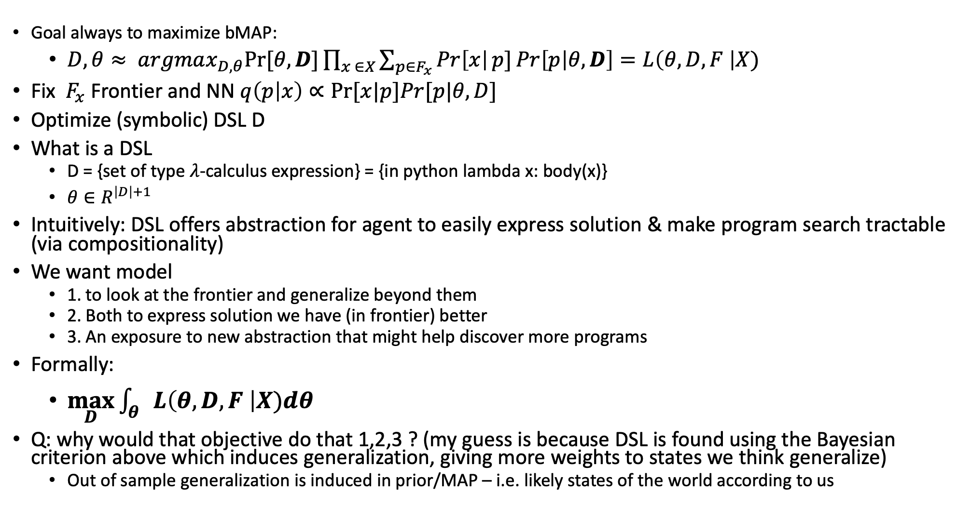
Compress (1): Learn DSL D -- compresses programs in frontier
Goal always to maximize bMAP:
$D, θ≈ argmax_{D, θ}Pr⁡[θ,D]\prod_{x ∈X}{\sum_{p∈F_{x}}{\operatorname{Pr}\left[x\right|p]\operatorname{Pr}\left[p | θ, D\right]=L\left(θ, D, F \right|X)}}$
Fix $F_{x}$ Frontier and NN $q\left(p | x\right)∝Pr⁡[x|p]Pr[p|θ, D]$
Optimize (symbolic) DSL D
What is a DSL
D = {set of type $λ$-calculus expression} = {in python lambda x: body(x)}
$θ∈R^{\left|D\right|+1}$
Intuitively: DSL offers abstraction for agent to easily express solution & make program search tractable (via compositionality)
We want model
1. to look at the frontier and generalize beyond them
2. Both to express solution we have (in frontier) better
3. An exposure to new abstraction that might help discover more programs
Formally:
$\max_{D}{\int_{θ}{L\left(θ, D, F \right|X)dθ}}$
Q: why would that objective do that 1,2,3 ? (my guess is because DSL is found using the Bayesian criterion above which induces generalization, giving more weights to states we think generalize)
Out of sample generalization is induced in prior/MAP – i.e. likely states of the world according to us
Notes:
The compress stage
1. offer abstraction that allow an agent to easily express solutions to the tasks at hand
2. Intuitively, **we want “to generalize beyond the frontier”** - both so that a) the DSL can offer abstraction to express solutions better to the current asks and b) DSL might expose new abstraction which will later be used to discover **more programs**.
Formally they claim this is achieved via: $\int_{θ}{L\left(θ, D, F | X\right)dθ}=\int_{θ}{P\left(θ, D\right)\prod_{x∈X}{\sum_{p∈F_{x}}{Pr\left[x | p\right]Pr[p|θ, D]}}}$
Q: how/why would that be true?
Q: they make an emphasis on “they extract programs that unify with the frontier, not only subexpressions.” I wonder what that really means and how the two are different. https://github.com/ellisk42/ec/issues/92
-–
Notes on AIC
They want to find a good DSL D that works in a bayesian "average" sense i.e. D = argmax_{D} int L(D, theta) dtheta. But that marginalization (sum/intergral) is hard so they approximate it with the AIC criterion. So:
D = argmax_{D} int L(D, theta) dtheta ~ argmax_{D} AIC(D)
note that min is usually done to AIC (e.g. 2k - 2log MAP(theta) ) so the - sign flips the AIC obj so to do a max. AIC is also 2k - 2ln(L), L = Likelihood objective. So the -2ln L you can put L for ML,MAP whatever your objective is.
k = # params.
Given a set of candidate models for the data, the preferred model is the one with the minimum AIC value. Thus, AIC rewards goodness of fit (as assessed by the likelihood function), but it also includes a penalty that is an increasing function of the number of estimated parameters.
When a statistical model is used to represent the process that generated the data, the representation will almost never be exact; so some information will be lost by using the model to represent the process. AIC estimates the relative amount of information lost by a given model: the less information a model loses, the higher the quality of that model. (is this true in overparm deep nets? I'd argue not)
In estimating the amount of information lost by a model, AIC deals with the trade-off between the goodness of fit (just fitting the data) of the model and the simplicity of the model. In other words, AIC deals with both the risk of overfitting and the risk of underfitting.
Akaike showed that this asymptotically chooses the model that is closes to the true f. e.g. if there are two models g1, g2 choose the one that losses less info e.g. less kl div from f. AIC does this approximately asymptotically.
Note that AIC tells nothing about the absolute quality of a model, only the quality relative to other models. Thus, if all the candidate models fit poorly, AIC will not give any warning of that. Hence, after selecting a model via AIC, it is usually good practice to validate the absolute quality of the model.

Slide 13
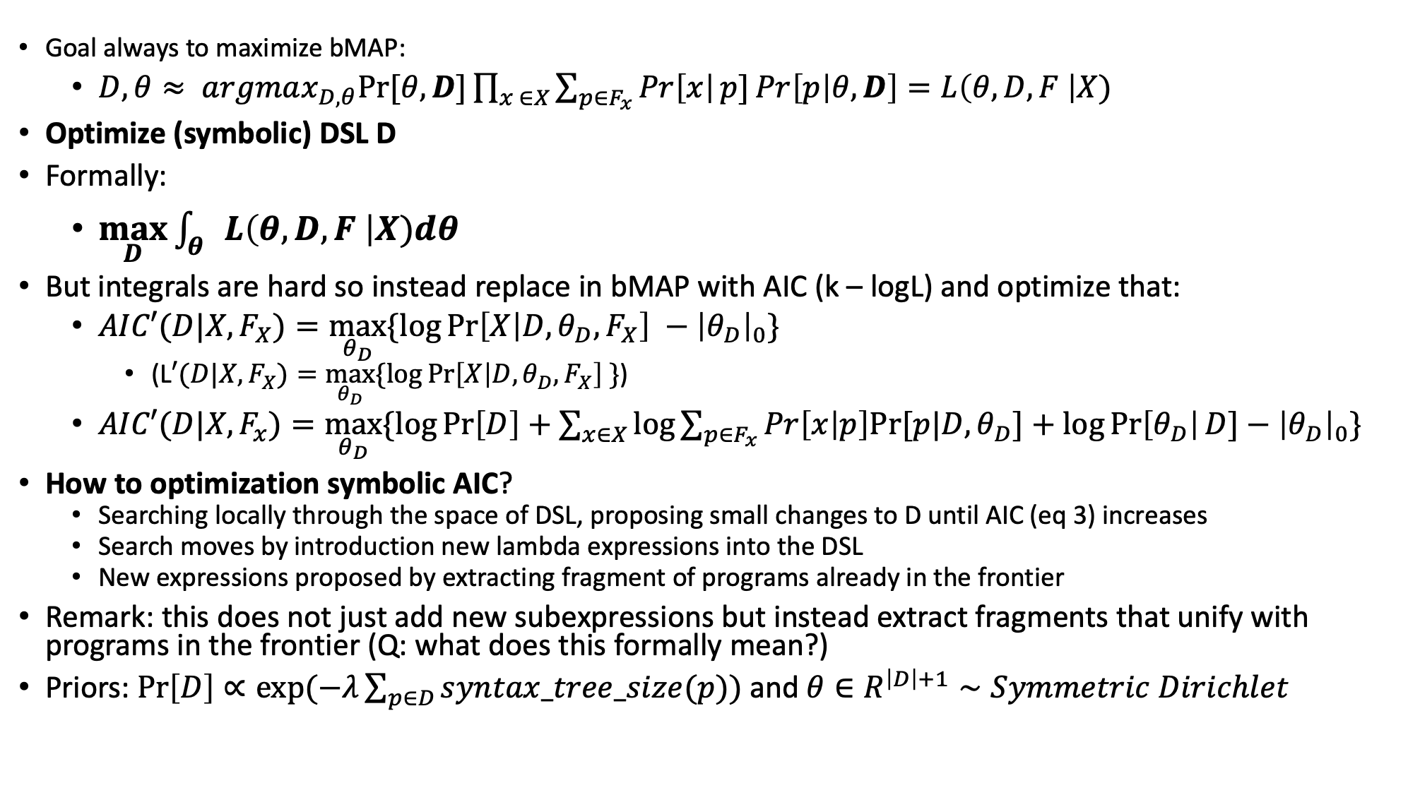
Compress (2): Learn DSL D -- compresses programs in frontier
Goal always to maximize bMAP:
$D, θ≈ argmax_{D, θ}Pr⁡[θ,D]\prod_{x ∈X}{\sum_{p∈F_{x}}{\operatorname{Pr}\left[x\right|p]\operatorname{Pr}\left[p | θ, D\right]=L\left(θ, D, F \right|X)}}$
Optimize (symbolic) DSL D
Formally:
$\max_{D}{\int_{θ}{L\left(θ, D, F \right|X)dθ}}$
But integrals are hard so instead replace in bMAP with AIC (k – logL) and optimize that:
$AIC′(D|X, F_{X})=\max_{θ_{D}}{\{\log{\operatorname{Pr}\left[X | D, θ_{D}, F_{X}\right]}} −{\left|θ_{D}\right|}_{0}\}$
(L$′(D|X, F_{X})=\max_{θ_{D}}{\{\log{\operatorname{Pr}\left[X | D, θ_{D}, F_{X}\right]}} \}$)
$AIC′(D|X, F_{x})=\max_{θ_{D}}{\{\log{\operatorname{Pr}\left[D\right]+\sum_{x∈X}{\log{\sum_{p∈F_{x}}{Pr\left[x | p\right]Pr⁡[p|D, θ_{D}]}}}}}+\log{\operatorname{Pr}\left[θ_{D}\right|D]}−{\left|θ_{D}\right|}_{0}\}$
How to optimization symbolic AIC?
Searching locally through the space of DSL, proposing small changes to D until AIC (eq 3) increases
Search moves by introduction new lambda expressions into the DSL
New expressions proposed by extracting fragment of programs already in the frontier
Remark: this does not just add new subexpressions but instead extract fragments that unify with programs in the frontier (Q: what does this formally mean?)
Priors: $\operatorname{Pr}\left[D\right]∝exp⁡(−λ\sum_{p∈D}{syntax_tree_size(p))}$ and $θ∈R^{\left|D\right|+1}∼Symmetric Dirichlet$
Notes:
The compress stage
1. offer abstraction that allow an agent to easily express solutions to the tasks at hand
2. Intuitively, **we want “to generalize beyond the frontier”** - both so that a) the DSL can offer abstraction to express solutions better to the current asks and b) DSL might expose new abstraction which will later be used to discover **more programs**.
Formally they claim this is achieved via: $\int_{θ}{L\left(θ, D, F | X\right)dθ}=\int_{θ}{P\left(θ, D\right)\prod_{x∈X}{\sum_{p∈F_{x}}{Pr\left[x | p\right]Pr[p|θ, D]}}}$
Q: how/why would that be true?
Q: they make an emphasis on “they extract programs that unify with the frontier, not only subexpressions.” I wonder what that really means and how the two are different. https://github.com/ellisk42/ec/issues/92
Max approximates integral (the one that contributes most to the integral/obj)
-–
Notes on AIC
They want to find a good DSL D that works in a bayesian "average" sense i.e. D = argmax_{D} int L(D, theta) dtheta. But that marginalization (sum/intergral) is hard so they approximate it with the AIC criterion. So:
D = argmax_{D} int L(D, theta) dtheta ~ argmax_{D} AIC(D)
note that min is usually done to AIC (e.g. 2k - 2log MAP(theta) ) so the - sign flips the AIC obj so to do a max. AIC is also 2k - 2ln(L), L = Likelihood objective. So the -2ln L you can put L for ML,MAP whatever your objective is.
k = # params.
Given a set of candidate models for the data, the preferred model is the one with the minimum AIC value. Thus, AIC rewards goodness of fit (as assessed by the likelihood function), but it also includes a penalty that is an increasing function of the number of estimated parameters.
When a statistical model is used to represent the process that generated the data, the representation will almost never be exact; so some information will be lost by using the model to represent the process. AIC estimates the relative amount of information lost by a given model: the less information a model loses, the higher the quality of that model. (is this true in overparm deep nets? I'd argue not)
In estimating the amount of information lost by a model, AIC deals with the trade-off between the goodness of fit (just fitting the data) of the model and the simplicity of the model. In other words, AIC deals with both the risk of overfitting and the risk of underfitting.
Akaike showed that this asymptotically chooses the model that is closes to the true f. e.g. if there are two models g1, g2 choose the one that losses less info e.g. less kl div from f. AIC does this approximately asymptotically.
Note that AIC tells nothing about the absolute quality of a model, only the quality relative to other models. Thus, if all the candidate models fit poorly, AIC will not give any warning of that. Hence, after selecting a model via AIC, it is usually good practice to validate the absolute quality of the model.
Q: how is search over D & theta actually done?

Slide 14
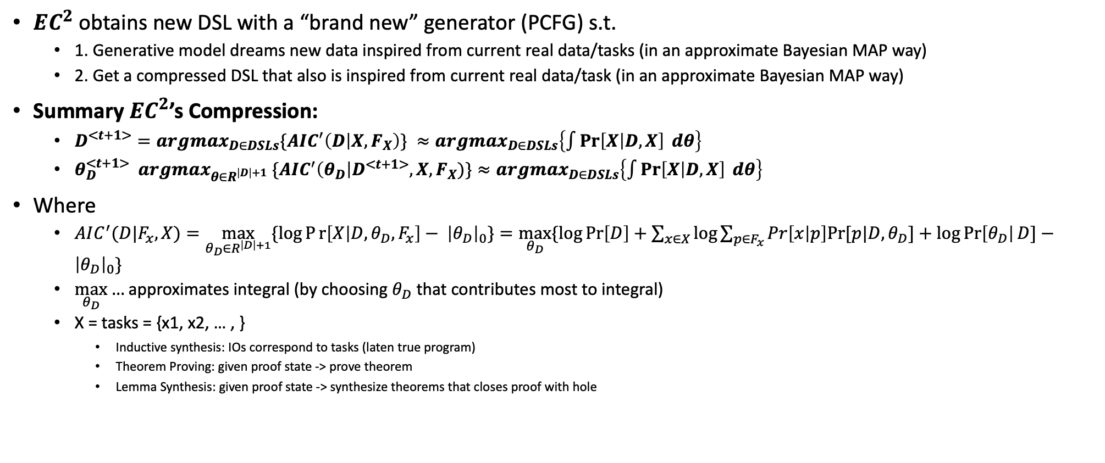
Compress (3): Learn DSL D -- compresses programs in frontier
$EC^{2}$ obtains new DSL with a “brand new” generator (PCFG) s.t.
1. Generative model dreams new data inspired from current real data/tasks (in an approximate Bayesian MAP way)
2. Get a compressed DSL that also is inspired from current real data/task (in an approximate Bayesian MAP way)
Summary $EC^{2}$’s Compression:
$D^{<t+1>}=argmax_{D∈DSLs}\{AIC^{′}\left(D | X, F_{X}\right)\} ≈argmax_{D∈DSLs}\left\{\int{\operatorname{Pr}\left[X | D, X\right] dθ}\right\}$
$θ_{D}^{<t+1>} argmax_{θ∈R^{\left|D\right|+1}} \{AIC^{′}\left(θ_{D}\right|D^{<t+1>}, X, F_{X})\}≈argmax_{D∈DSLs}\left\{\int{\operatorname{Pr}\left[X | D, X\right] dθ}\right\}$
Where
$AIC^{′}(D|F_{x}, X)=\max_{θ_{D}∈R^{\left|D\right|+1}}{\{\log{Pr\left[X | D, θ_{D}, F_{x}\right]}}− {\left|θ_{D}\right|}_{0}\}=\max_{θ_{D}}{\{\log{\operatorname{Pr}\left[D\right]+\sum_{x∈X}{\log{\sum_{p∈F_{x}}{Pr\left[x | p\right]Pr⁡[p|D, θ_{D}]}}}}}+\log{\operatorname{Pr}\left[θ_{D}\right|D]}−{\left|θ_{D}\right|}_{0}\}$
$\max_{θ_{D}}{…}$approximates integral (by choosing $θ_{D}$ that contributes most to integral)
X = tasks = {x1, x2, … , }
Inductive synthesis: IOs correspond to tasks (laten true program)
Theorem Proving: given proof state -> prove theorem
Lemma Synthesis: given proof state -> synthesize theorems that closes proof with hole

Slide 15
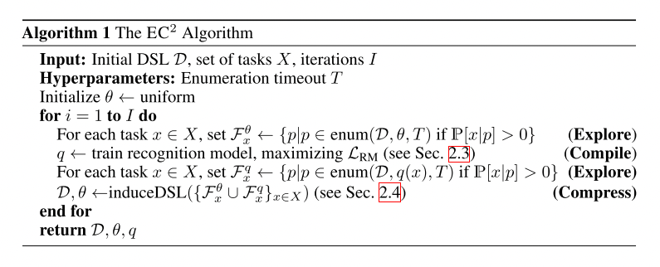
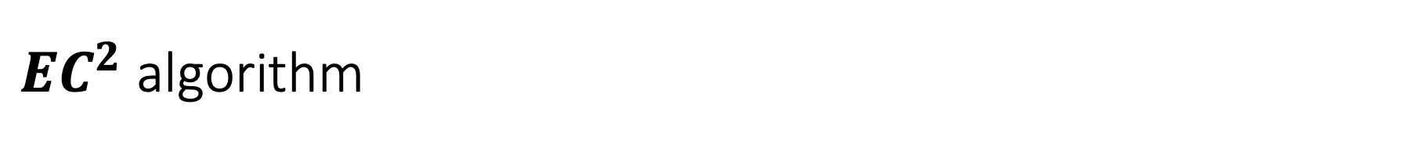
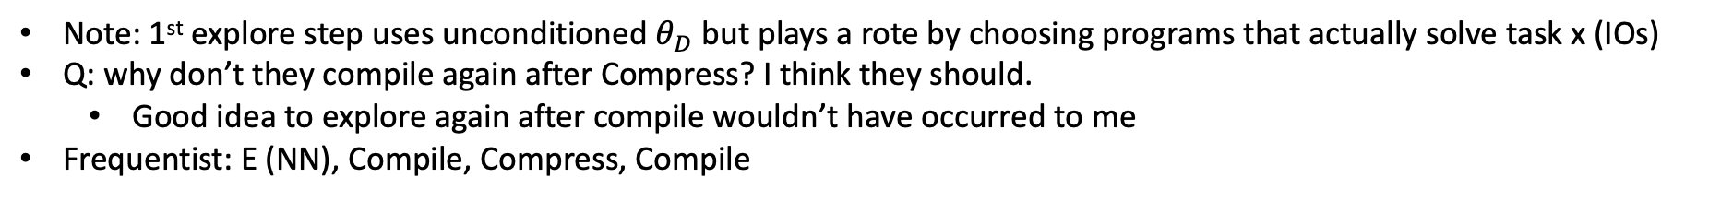
$EC^{2}$ algorithm
Note: 1st explore step uses unconditioned $θ_{D}$ but plays a rote by choosing programs that actually solve task x (IOs)
Q: why don’t they compile again after Compress? I think they should.
Good idea to explore again after compile wouldn’t have occurred to me
Frequentist: E (NN), Compile, Compress, Compile
Notes:
I personally would have added another compile after compress to improve search in the Explore phase – since the DSL compressed the search space & the NN would not really predict new constructs since it has never seen them. Has no reason to predict unknown constructs (unless they have their own embeddings built compositionally e.g. via attention instead of hardcoded new neurons)
Personally I’d compile a bit more after Compress, especially for the NR model (or EGen) – since that would increase the chance of assigning high probs to new abstractions…no? Otherwise why doesn’t it assign probability zero to new abstractions?

Slide 16
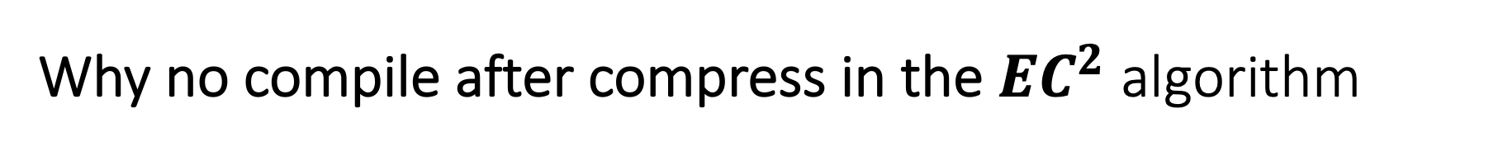
Why no compile after compress in the $EC^{2}$ algorithm
Why not compile right after compress?
Especially if the Neural model has never seen these new DSL expressions?
Short answer:
they could but in the next iteration of loop, they do explore/synthesis/search right away with the new DSL and the params of the generative model NOT the Neural model
So it either didn’t make a difference or they felt it wasn’t needed
Notes:
Hi Jason!
I thought about this a bit and I think I know the answer finally. First I think it's important to clarify some (implicit) terminology in EC^2/DC (this distinction took me some time to realize). First for the authors there is a distinction between synthesis vs generation/dreaming. Synthesis is target with a task at hand e.g. IOs or sketch with holes to fill. Generation for them is more like dreaming, coming up with programs from scratch. They have to generate the IOs for them later. The confusion (to me at least) is that both models (the generative DSL & Neural model) can be used to guide the synthesis (enumerative process). But the neural model for them cannot generate/dream. Thus, the new DSL is new for the neural model. However, if you notice in their actual implementation of the EC^2 algorithm them first do an explore (synthesis) step with the parameters of the DSL. Then they immediately do the compile step. But this assumes the new DSL since it happens after the compress when you start a new loop. So the neural model *does* learn to assign probabilities to the new DSL due to that. Perhaps my complaint is that you already did the compression and you can already do a compile right away. That is true and perhaps that would be especially good for a transformer that can take more data and updates than their neural recognition model that is not a transformer. I think that is the main reason. The risk they have is that the explore step they have doesn't leverage the fact that you already have a bunch of terms you compress, so in a way they have less experience with this DSL. In my view I would compile right away since that gives the neural model twice as much exposure to the new DSL instead of one. The work I'm thinking there isn't a natural dreamer/generative model. In this case the algorithm could be:
F_x <- Explore with EGen and new DSL (transfomrer)
Compile EGen with F_x (learns new DSL constructs from previous step, just a fitting step)
DSL' <- Compress current F_x (so gets new DSL)
Compile EGen with F'_x (learns new DSL constructs from *this* step, again just a fitting step)
The enumerator I had in mind can already do both.
Unless of course we train an explicit generative dreamer model that specializes only to dream for some reason -- which could be a good idea but requires more thinking.

Slide 17
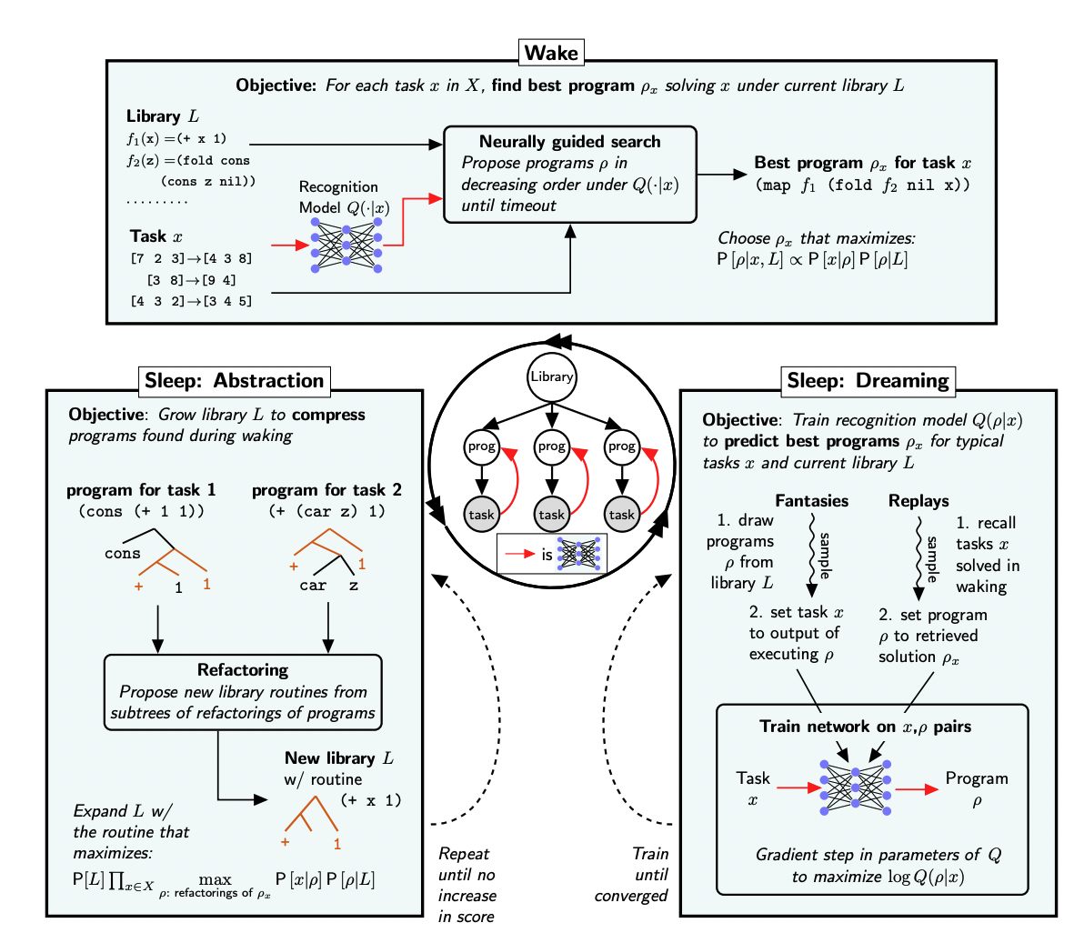
Summary of EC^2 (and DreamCoder)
EC^2 lingo = DreamCoder ling
Wake = Execute
Sleep: Abstraction = Compress
Sleep: Dreaming = Compile (fitting)
Note:
Each of these phases bootstrap/improve each other
Notes:
I personally would have added another compile after compress to improve search in the Explore phase – since the DSL compressed the search space & the NN would not really predict new constructs since it has never seen them. Has no reason to predict unknown constructs (unless they have their own embeddings built compositionally e.g. via attention instead of hardcoded new neurons)

Slide 18
Observation: Comparison of with RL
EC^2/DC like methods are semi-supervised (e.g. ground truth program is not usually known)
Their Evaluation wrt IOs is similar to evaluations to Oracle (Coq) if the proof is correct
But, in EC^2 after the Explore step – if it fails then there is **no reward in Compile step**
EC^2 lacks a useful negative reward if the synthesis/execute from IOs (or acceptance of Coq) fails
However, RL **does give a reward**
But despite that, the challenge is that RL rewards will be sparse
How to unsparsify?!
Implicit Assumption of EC^2 is that tasks (solving proof via lemma gen or synthesis that satisfy IOs) are somehow ordered such that the knowledge of the model/system can be incrementally (meta) learned!
I’d say specially true in TP! Especially with human proofs – as seed that is ALWAYS available
curriculum
Similar to general code – the reality is that github code will not go anywhere/dissapear ☺
Notes:
Local mistake

Slide 19
Conclusions
Scales up Program induction by **learning the action space** – the library DSL!
Never before had the action space library itself been learned successfully
Works on a diverse union of tasks/prboems
– so EC^2 is an effective Meta-Learner
Learns a generative model using a Probabilistic Context Free Grammar (PCFG)
Surprisingly, only part that has a Neural Net is the Enumeration + Neural Recognition model (neural guider)
Doesn’t reward very well on failures to solve task (since that produces no labels to improve NN)
Intermediate rewards for failures especially hard if attempted to be given
Sparse rewards if using RL! (that’s why they use a SL/Alternate Maximization style approach)
Related to previous point, really requires some sort of “curriculum” to be able to bootstrap
E.g. given medium-hard set of problems algorithm is stuck – especially since it has no way of learning well from negative examples/failures to synthesize

Slide 20
References
DC:
https://arxiv.org/abs/2006.08381
https://pldi21.sigplan.org/details/pldi-2021-papers/55/DreamCoder-Bootstrapping-Inductive-Program-Synthesis-with-Wake-Sleep-Library-Learnin
EC^2: https://papers.nips.cc/paper/2018/hash/7aa685b3b1dc1d6780bf36f7340078c9-Abstract.html

Slide 21
End
Hope you learned a lot!

Slide 22
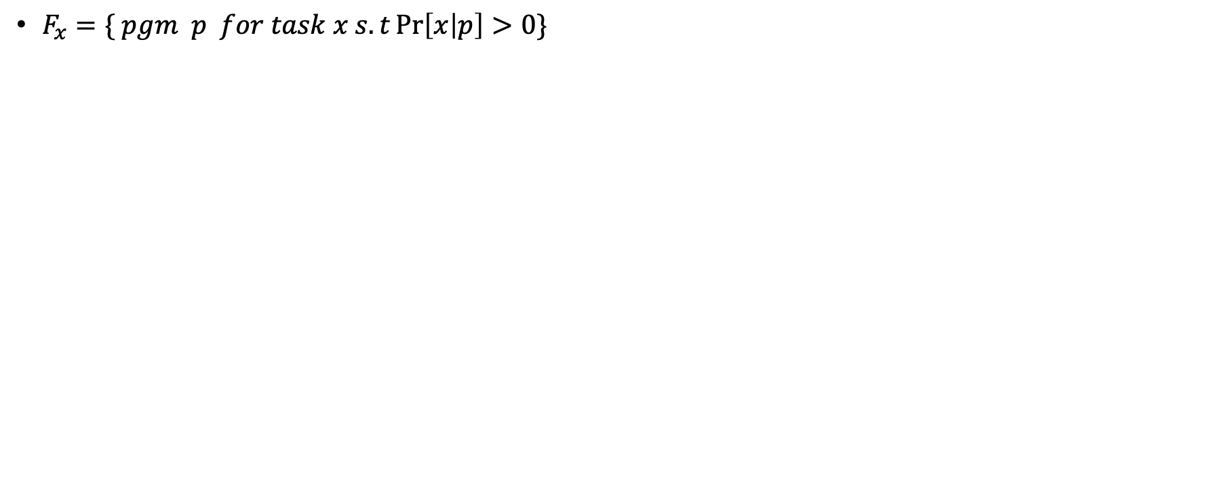
Some Terminology/Notation
$F_{x}=\{ pgm p for task x s.t\operatorname{Pr}\left[x | p\right]>0\}$

Slide 23
FAQs

Slide 24
Question1: how to define Pr[x|p] & Pr[p|x, D, \theta]?
Q: **how do you assign the probability of two different programs that satisfy the IOs**
How is Pr[x|p] defined? If x is a set of IOs. P is a pgm. Then it either satisfies the IOs or it does not. Yes, there are many p’s that satisfy IOs in x but how do you weight them differently?
You might think by length of p, but isn’t that what Pr[p|\theta, D] does?
Pr[x|p] is similar to asking Pr[p*|p] i.e. how likely is the program p* given program p that is in the frontier (or program are about to synthesize)
This is similar to asking how similar Pr[x|p]<-> Pr[p*|p]. In a way we are asking how similar is p* and p? knowing if they are equivalent is undecidable – but if it’s ”understandable” then humans can “figure it out”. But your never sure 100% so you are quantifying how likely you think the program given (i.e. p) is the true program
Pr[x|p] in a way quantifies the belief that program p (likely in frontier, or we are going to synthesize) is the ground truth program related to x? How likely is the IOs x given our program p?
Yes, x is given and either p outputs x or not but if you were to compare it with p* you might give it a different weighting…maybe due to it’s length or how many components it is re-using from the library
For example, if you have 2 p’s p1, p2, you’d likely assign a higher weight to the p that uses the more blocks from your DSL (rather than arbitrary code even if it works). Like, your more likely to choose p that uses human code – if you were coding that’s what you’d choose most likely!
So that would give Pr[x |p, D, theta] – which is not what the authors have, so, puzzling! What is Pr[x|p] supposed to mean? **how do you assign the probability of two different programs that satisfy the IOs**?

Slide 25
Question2: how do they define the generative model from the DSL? Seems like magic!
Q:
This question might be equivalent to the previous question
i.e. how to define Pr[x|p] & Pr[p|x, D, \theta]
If we know how to sample programs, we must know something about the probability distribution that generates programs!
Actually just realized I will likely know the answer to this (at least from the fragment grammar perspective) once I finish reading my fragment grammar book
i.e. PCFG

Slide 26
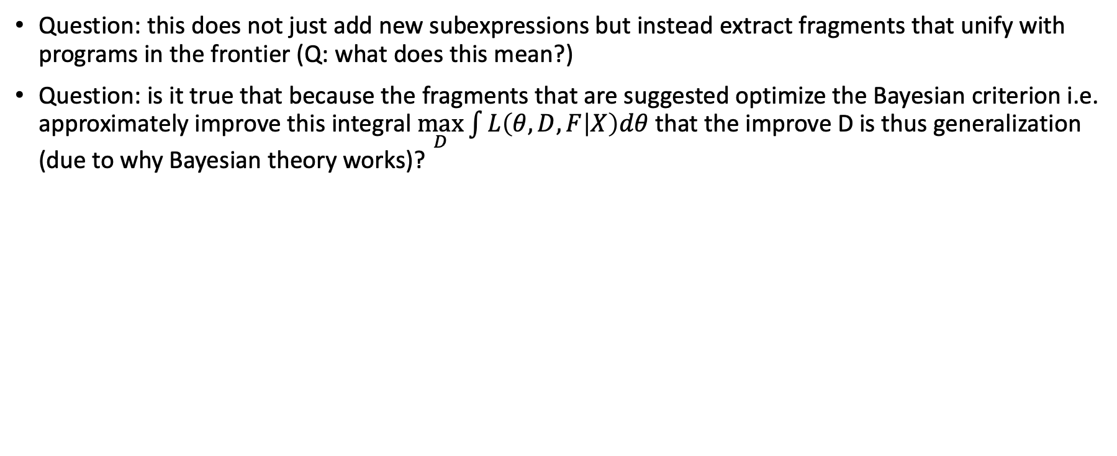
Questions 3: Compress
Question: this does not just add new subexpressions but instead extract fragments that unify with programs in the frontier (Q: what does this mean?)
Question: is it true that because the fragments that are suggested optimize the Bayesian criterion i.e. approximately improve this integral $\max_{D}\int{L\left(θ, D, F | X\right)dθ}$ that the improve D is thus generalization (due to why Bayesian theory works)?

Slide 27
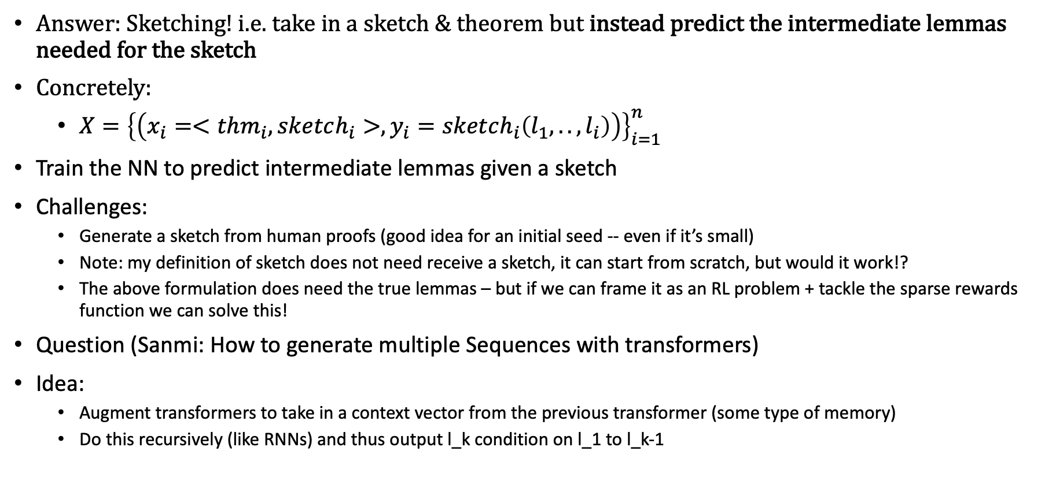
Idea1: How do we avoid predicting entire proofs as a program synthesis problem?
Answer: Sketching! i.e. take in a sketch & theorem but instead predict the intermediate lemmas needed for the sketch
Concretely:
$X={\left\{\left(x_{i}=<thm_{i}, sketch_{i}>, y_{i}=sketch_{i}\left(l_{1},..,l_{i}\right)\right)\right\}}_{i=1}^{n}$
Train the NN to predict intermediate lemmas given a sketch
Challenges:
Generate a sketch from human proofs (good idea for an initial seed -- even if it’s small)
Note: my definition of sketch does not need receive a sketch, it can start from scratch, but would it work!?
The above formulation does need the true lemmas – but if we can frame it as an RL problem + tackle the sparse rewards function we can solve this!
Question (Sanmi: How to generate multiple Sequences with transformers)
Idea:
Augment transformers to take in a context vector from the previous transformer (some type of memory)
Do this recursively (like RNNs) and thus output l_k condition on l_1 to l_k-1

Slide 28
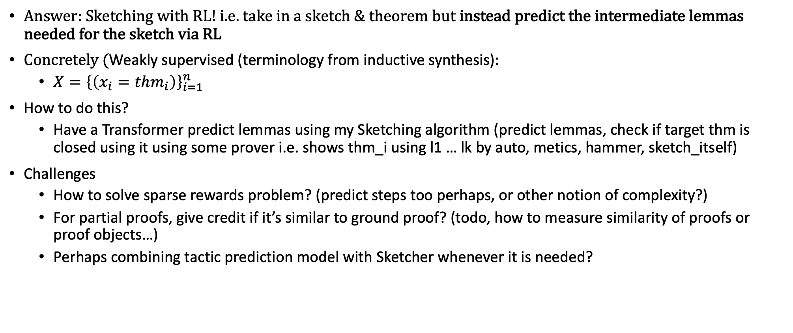
Idea2: How do we avoid predicting entire proofs as a program synthesis problem – without ground truth lemmas?
Answer: Sketching with RL! i.e. take in a sketch & theorem but instead predict the intermediate lemmas needed for the sketch via RL
Concretely (Weakly supervised (terminology from inductive synthesis):
$X={\left\{\left(x_{i}=thm_{i}\right)\right\}}_{i=1}^{n}$
How to do this?
Have a Transformer predict lemmas using my Sketching algorithm (predict lemmas, check if target thm is closed using it using some prover i.e. shows thm_i using l1 … lk by auto, metics, hammer, sketch_itself)
Challenges
How to solve sparse rewards problem? (predict steps too perhaps, or other notion of complexity?)
For partial proofs, give credit if it’s similar to ground proof? (todo, how to measure similarity of proofs or proof objects…)
Perhaps combining tactic prediction model with Sketcher whenever it is needed?

Slide 29
Comments:
I think it would have been good if EC^2 & DC would have acknowledge or compared their method with expert iteration (i.e. use no dreaming). It is a combination of it + wake sleep.
Another comment. Very similar to my meta-learning algorithm using Position Evaluators
The idea is similar:
You have an initial tactic predictor and a proof search algorithm that uses PosEval
Use both to get more proofs and an improved version of the data set of steps
Then improve PosEval with these new steps
Then fine-tune Tactic-Predictor to encourage it to predict tactics that lead to shorter proofs
Then repeat. This is also expert iteration like EC^2/DC. It only lacks the dreaming since there is no generative model (perhaps arguably a big disadvantage)

Slide 30
Overview of Fragment Grammers from EC^2
todo

Slide 31
Overview of E-graphs (from DreamCoder)
todo

